Slide 1

DOĞA SCHOOLS WELCOME
YOU ☺

Slide 2
We are happy to host your school for the celebrations of
April 23rd,
National Sovereignty and Children’s Day.

Slide 3
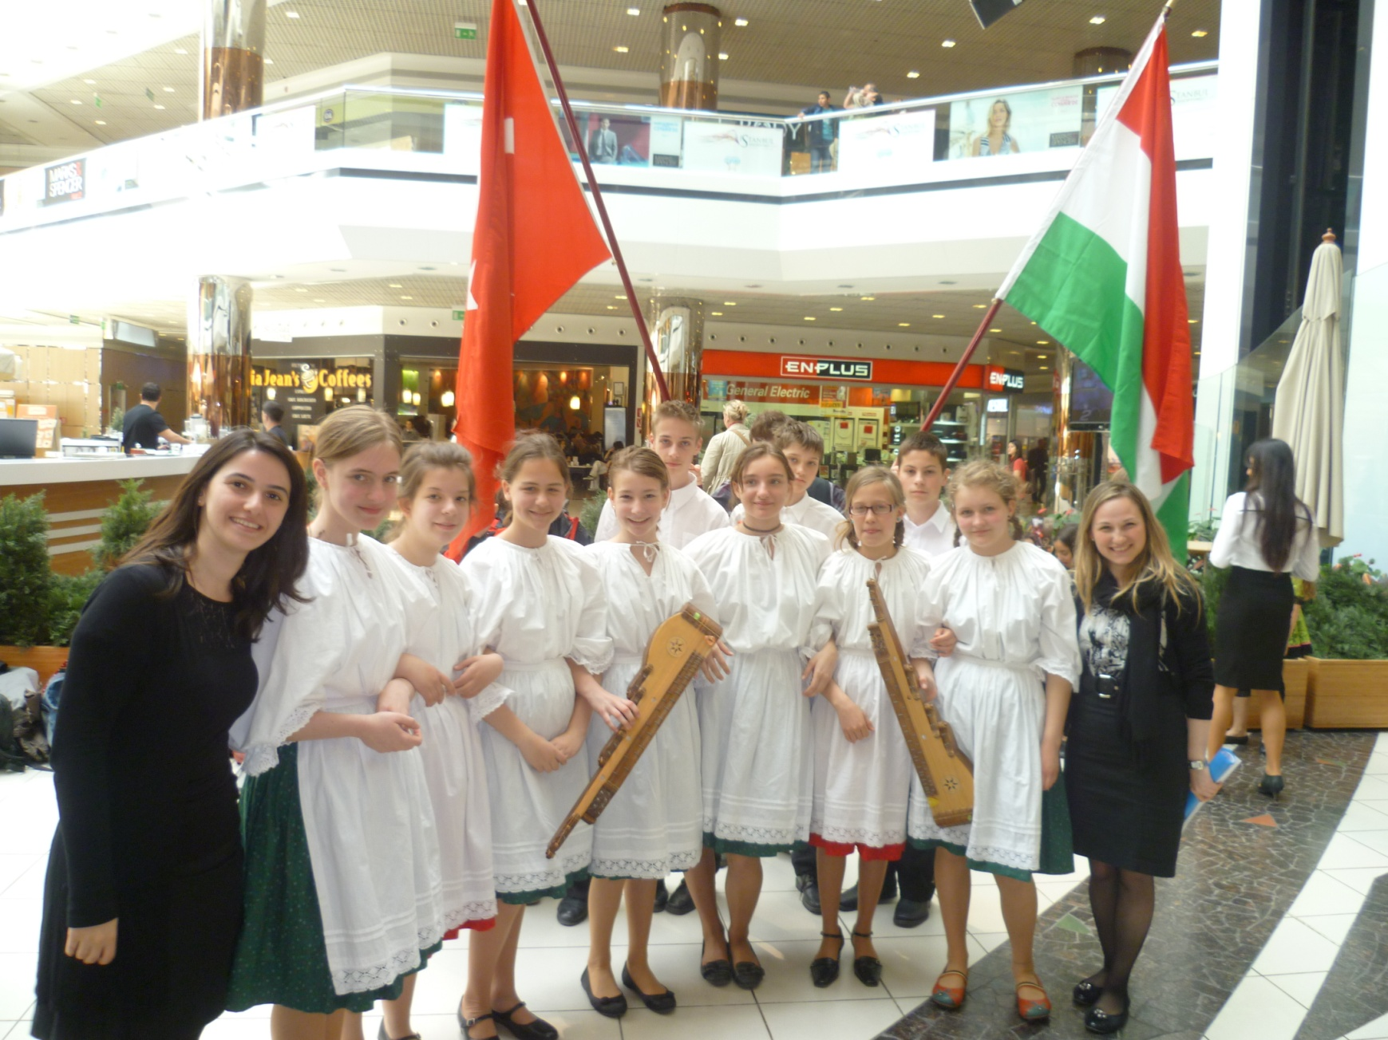
CELEBRATIONS IN 2011

Slide 4
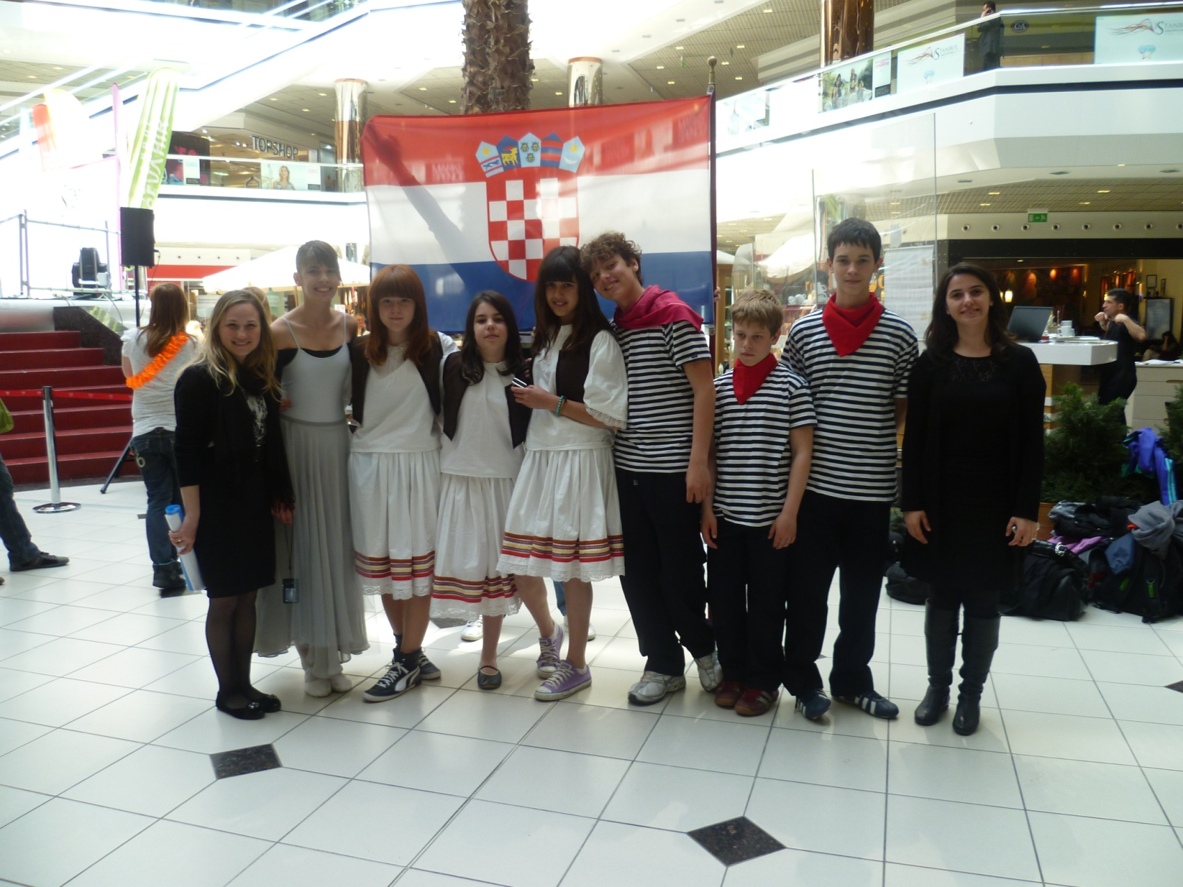
CELEBRATIONS IN 2011

Slide 5
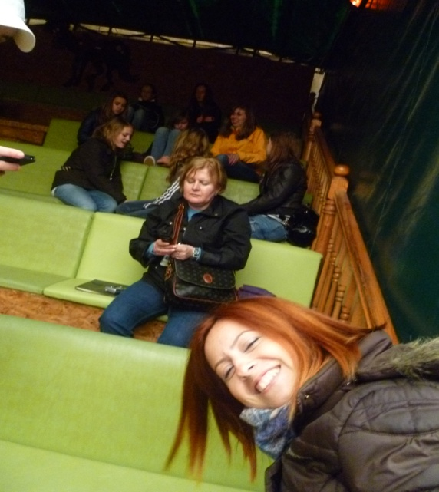
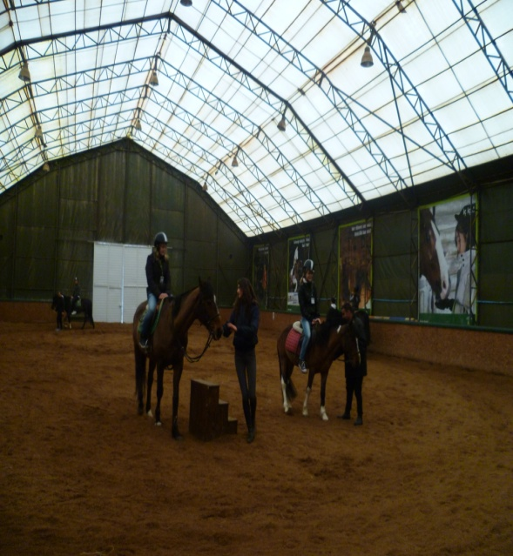
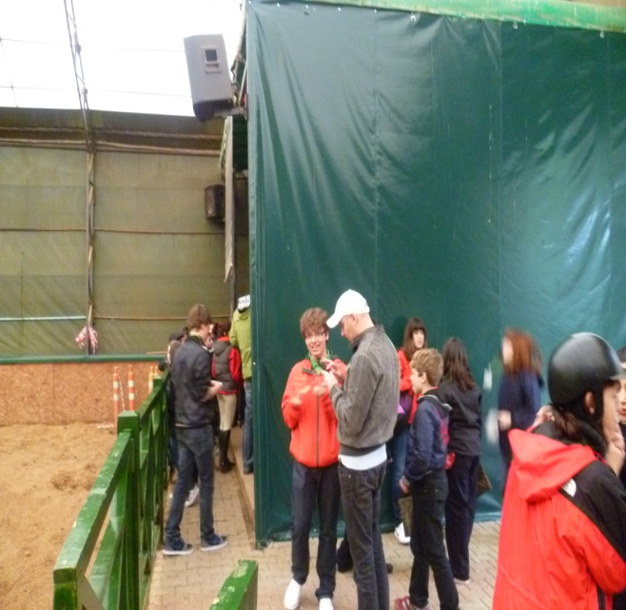
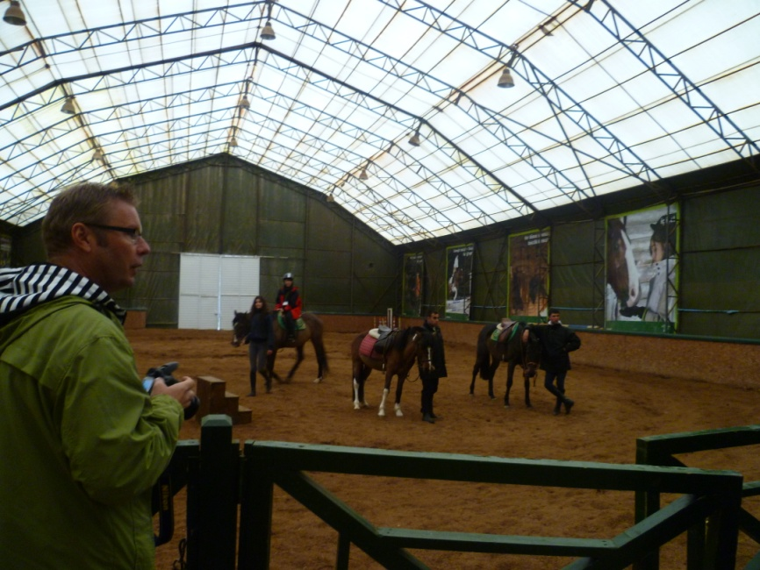
CELEBRATIONS IN 2011

Slide 6
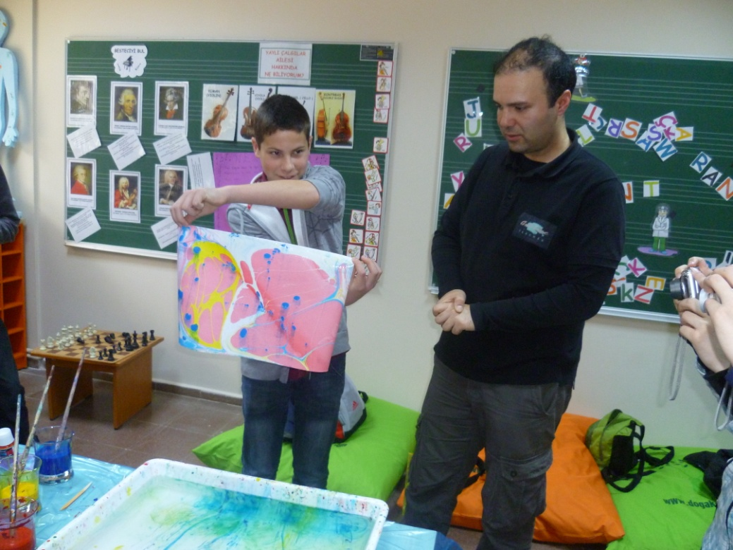
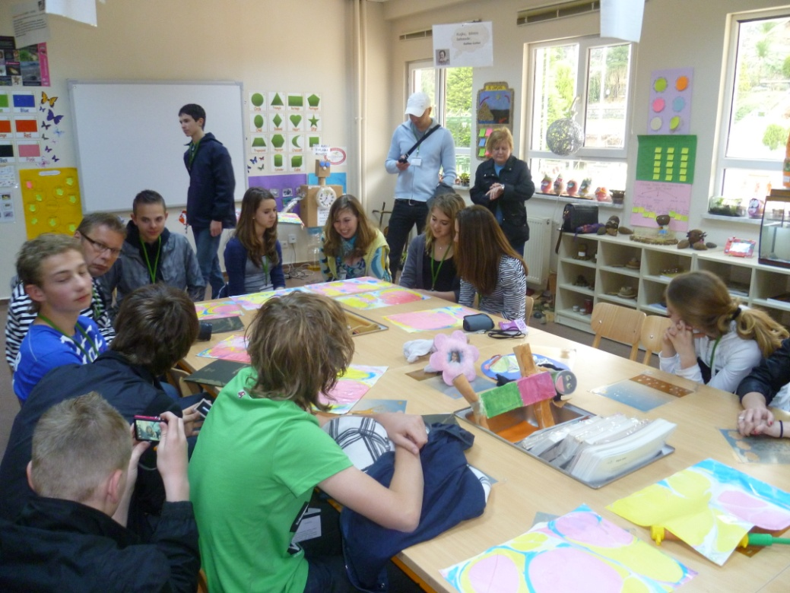
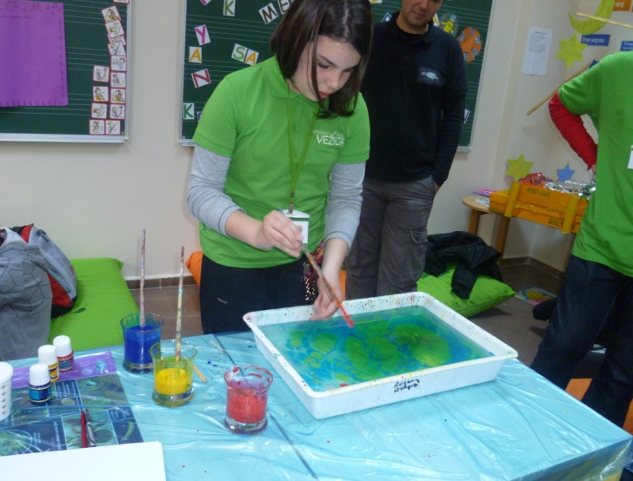
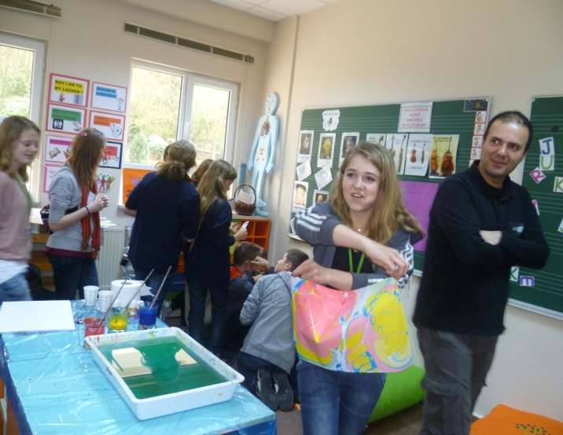
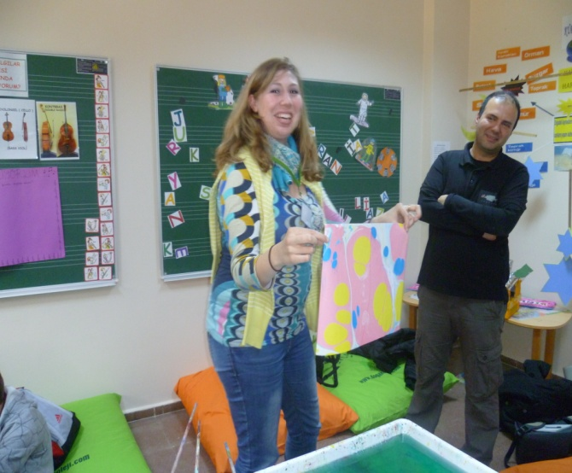
CELEBRATIONS IN 2011

Slide 7
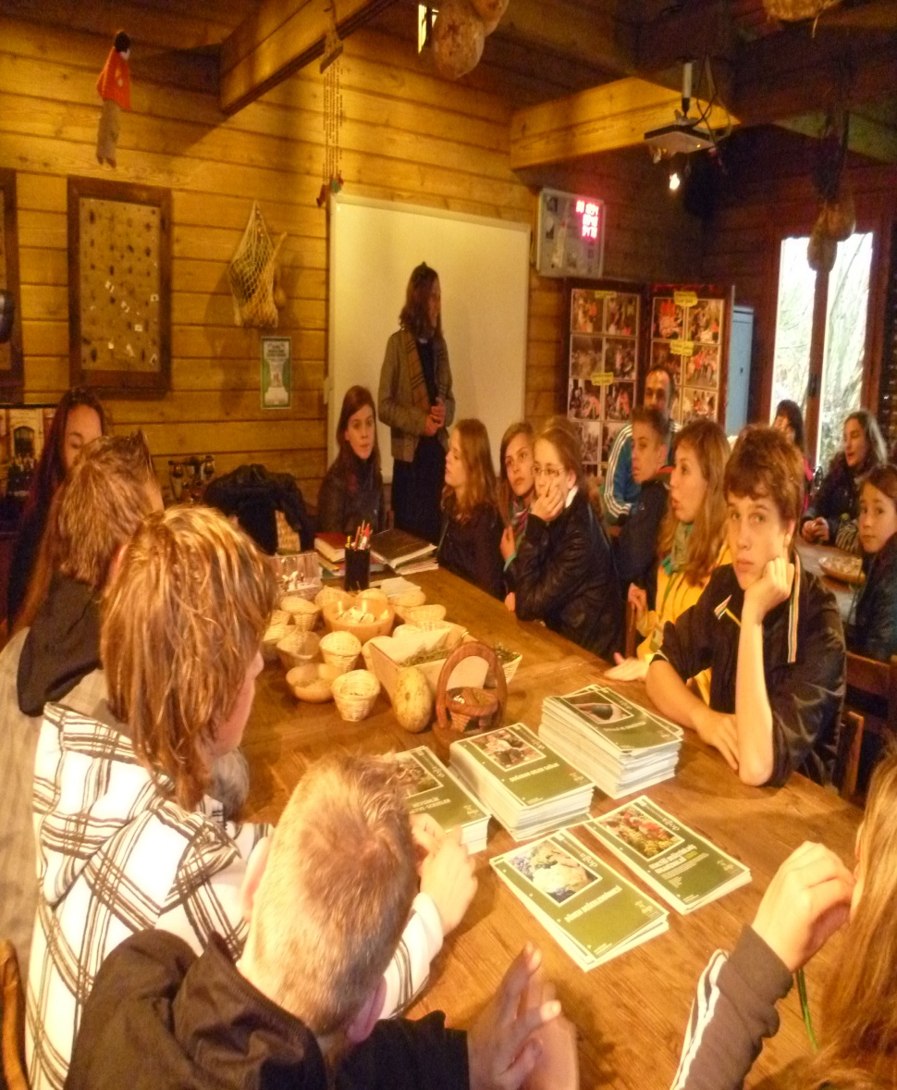
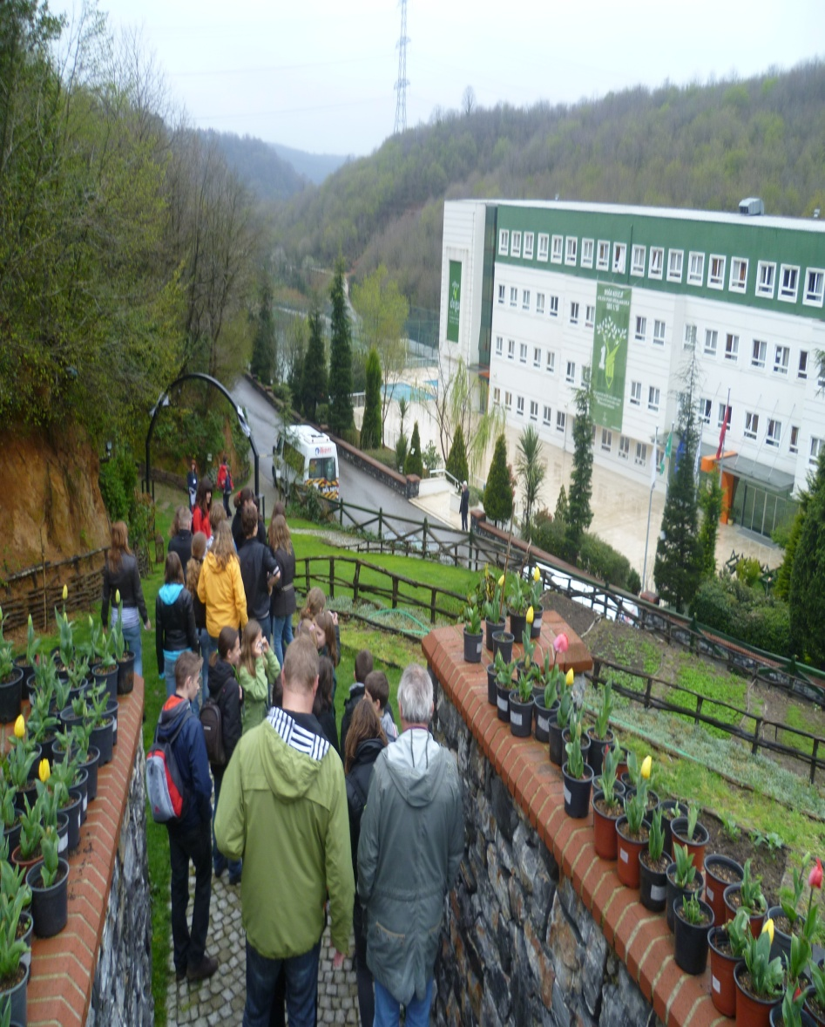
CELEBRATIONS IN 2011

Slide 8
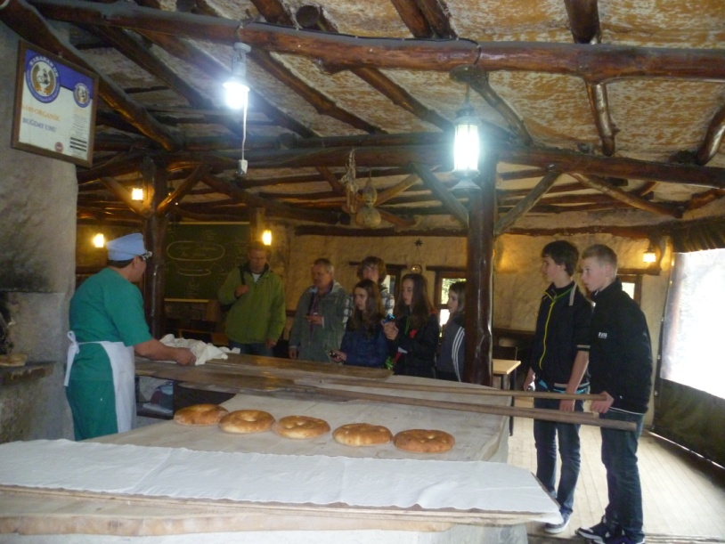
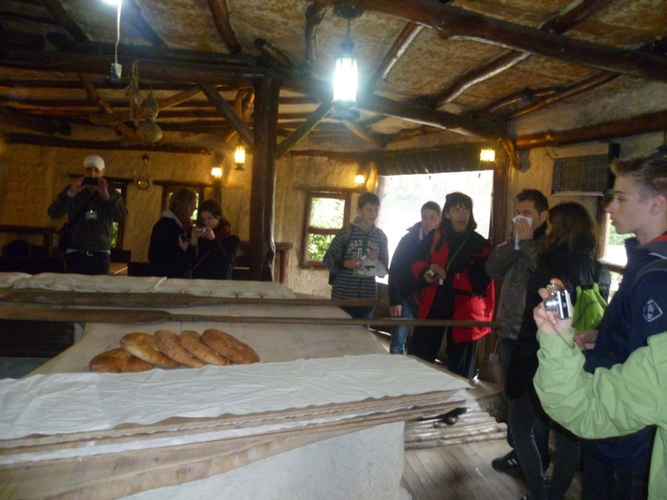
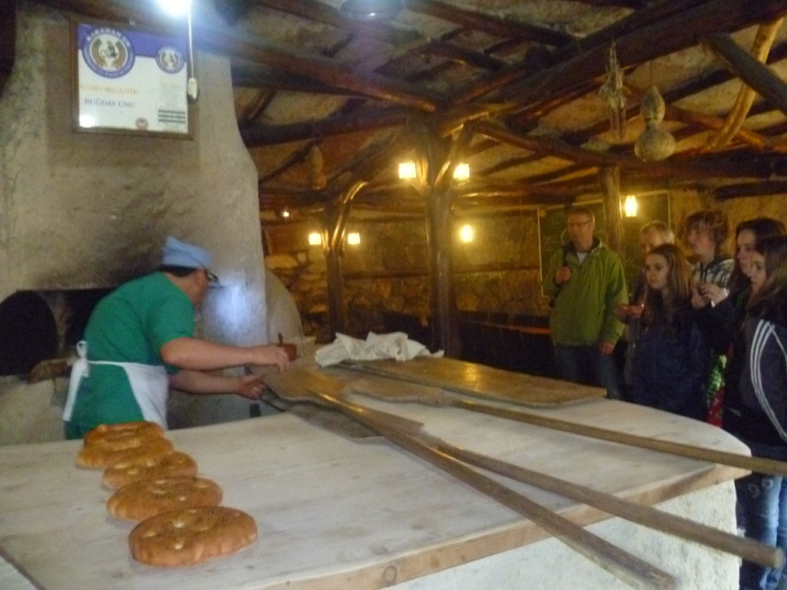
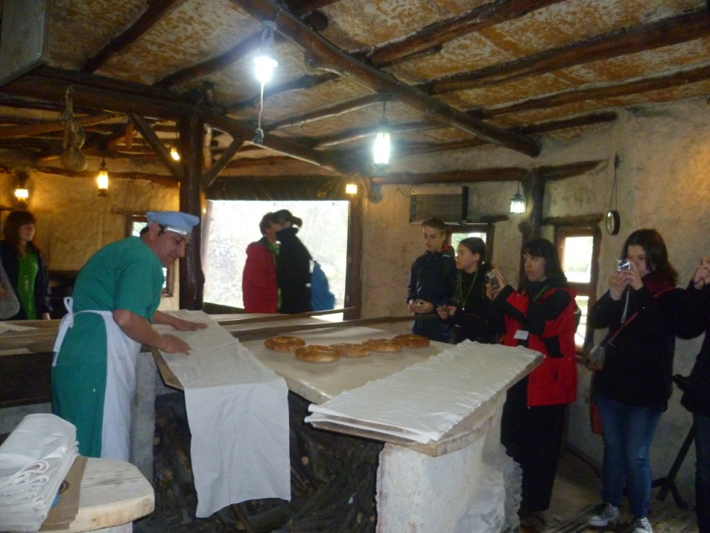
CELEBRATIONS IN 2011

Slide 9
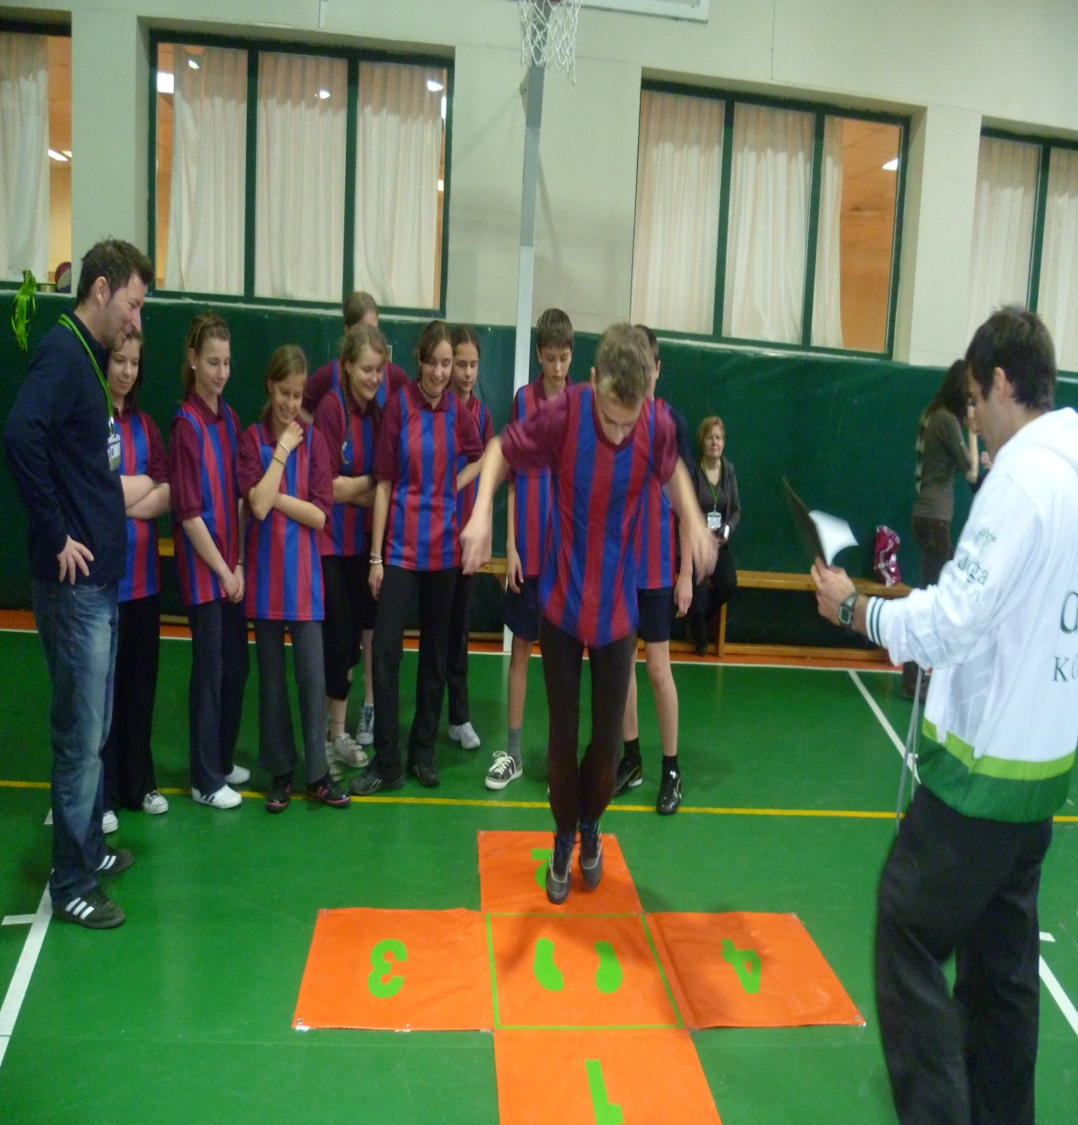
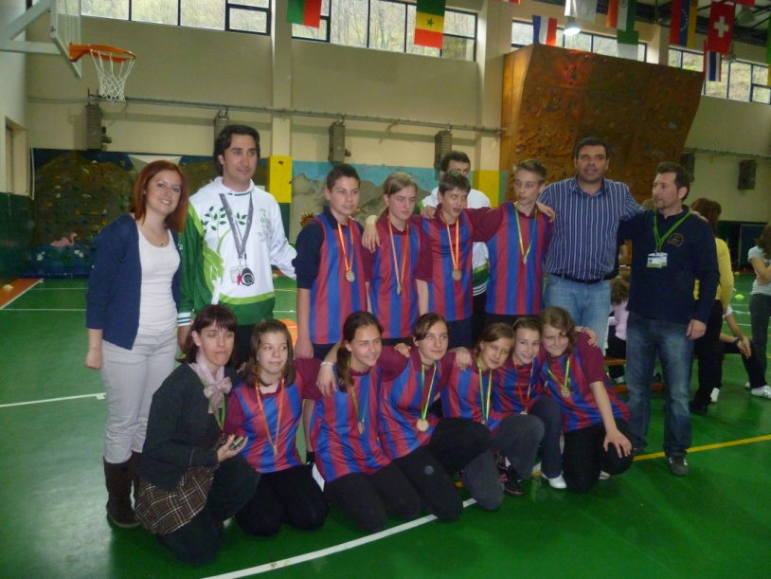
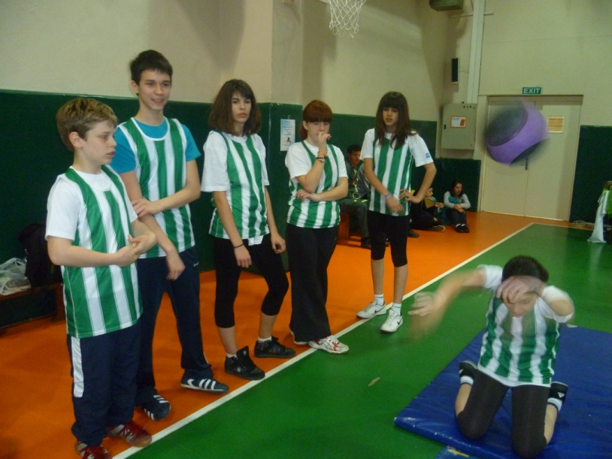
CELEBRATIONS IN 2011

Slide 10
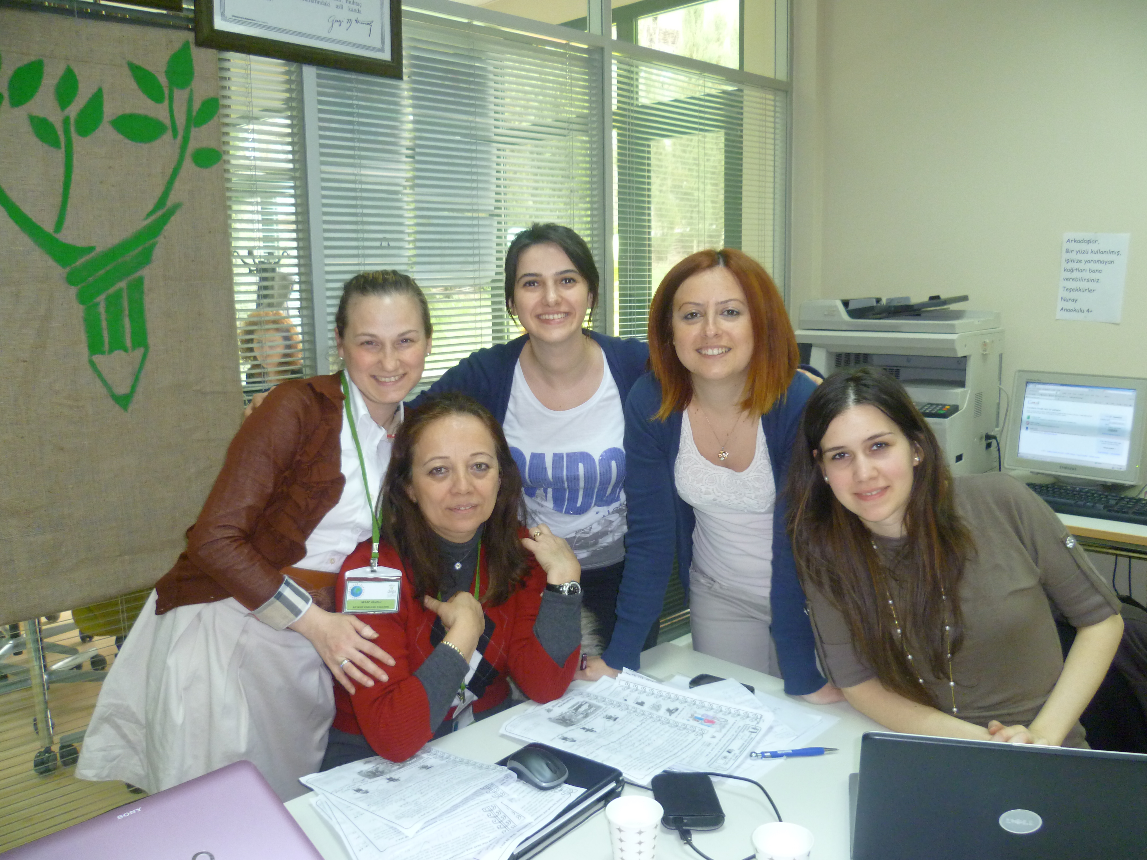
CELEBRATIONS IN 2011

Slide 11
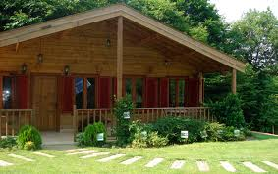
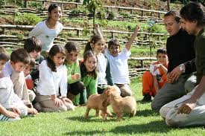

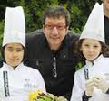
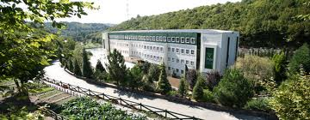
Beykoz Doğa Primary School
İstanbul - TÜRKİYE

Slide 12
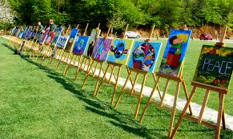
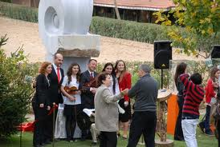
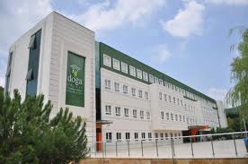
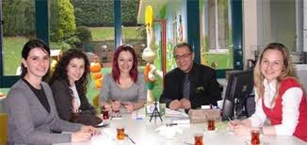
Beykoz Doğa Primary School
İstanbul - TÜRKİYE

Slide 13
THE PLACES WE VISITED AND THE ACTIVITIES WE HAD PREVIOUS YEARS

Slide 14
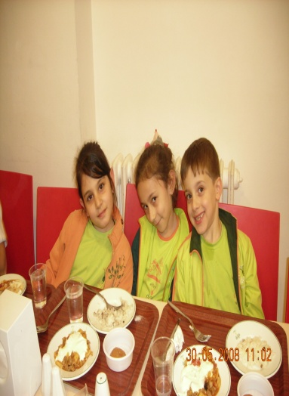
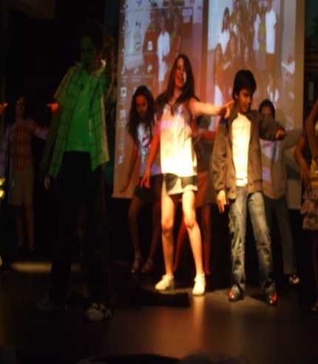
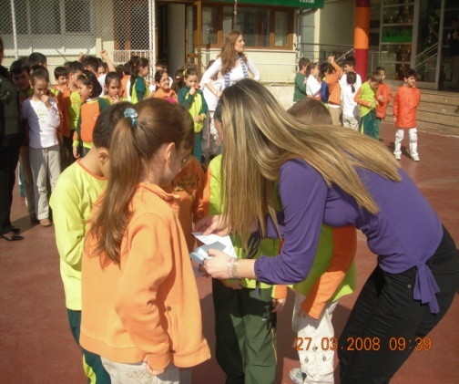
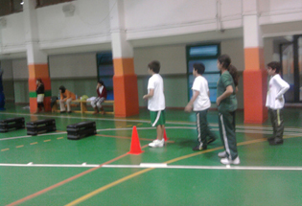
19th of April,2010
Welcome meeting & Introduction of the school
09:00 – 09:30 = BREAKFAST WITH THE STUDENTS
09:45 – 10:45 = LEARNING “GREASE LIGHTNING “ DANCE
11:00 – 12:00 = TREASURE HUNT
12:10 – 13:10 = LUNCH
13:30 – 14:30 = WORD CATCHING
14:45 – 15 :45 = KIDS ATHLETICS

Slide 15
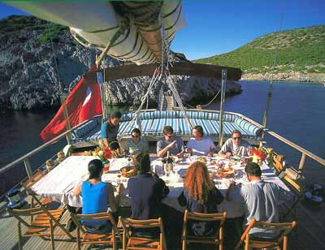
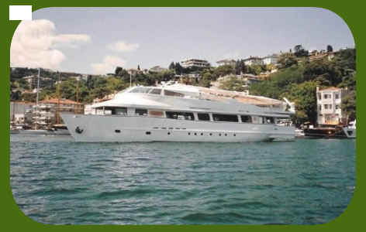
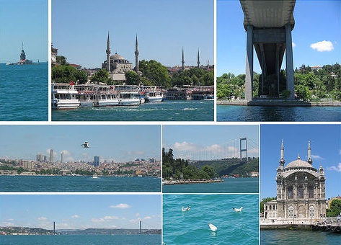
20th of April, 2010
MORNING: CAMPUS BASED ACTIVITIES
AFTERNOON: BOSPHOROUS BOAT TOUR

Slide 16
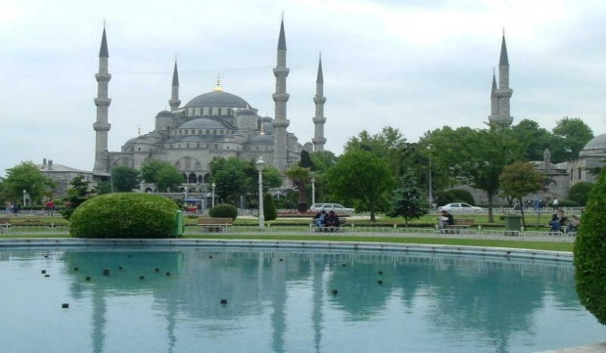
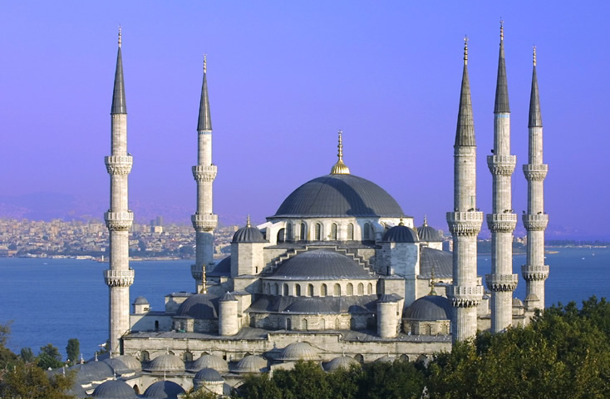
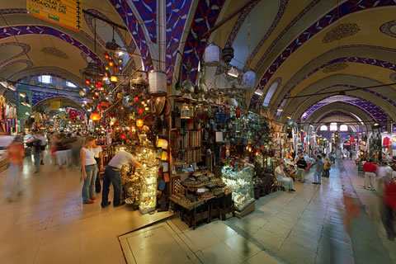
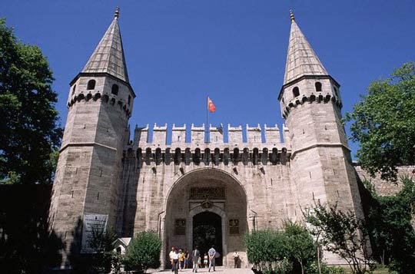
21st of April, 2010
TOPKAPI PALACE
BLUE MOSQUE
GRAND BAZAAR

Slide 17
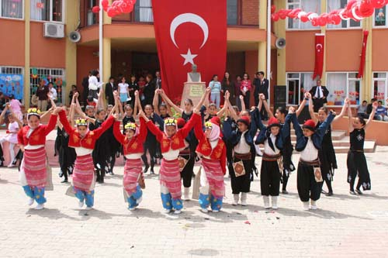
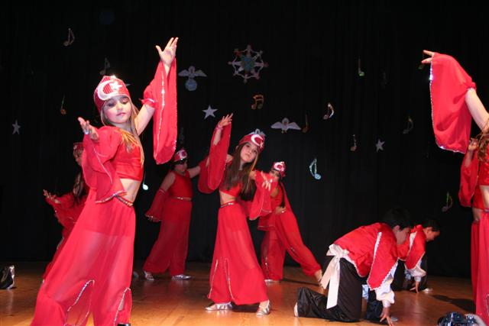
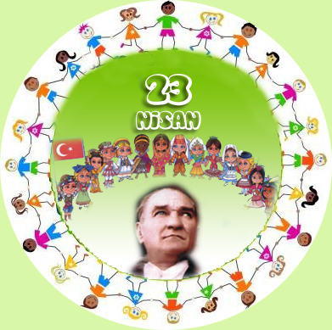
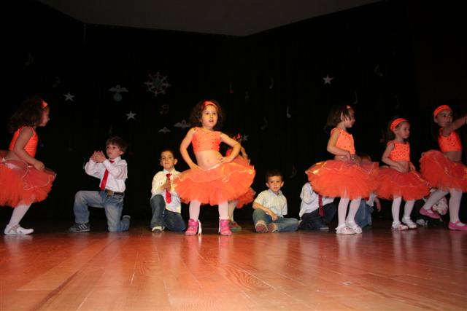
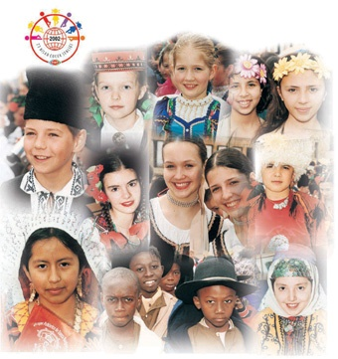
22nd of April, 2010
Celebration of Children Fest
at BEYKOZ DOĞA PRIMARY
SCHOOL

Slide 18
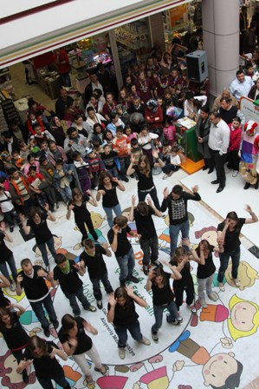
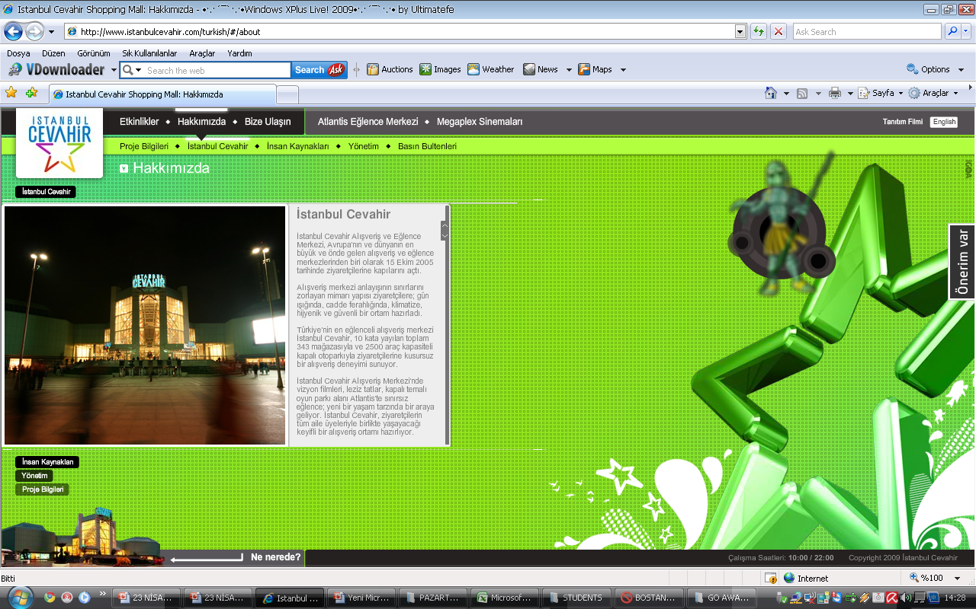
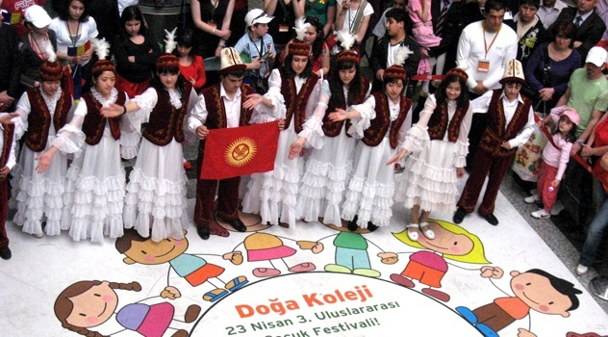
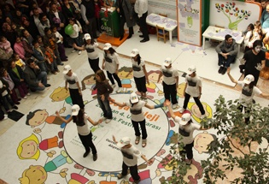
23rd of April, 2010
Celebration of Children Fest
in Beykoz and the
Performances in shopping centres
Shopping
centre
Closing Party & Ceremony at BEYKOZ DOĞA PRIMARY SCHOOL

Slide 19
We will be happy to host your school for the celebrations of
April 23rd,
National Sovereignty and Children’s Day. ☺

